Slide 1



ME504
Presentation

Slide 2

PROBLEM STATEMENT
Variant 7 : Consider three fixed forces of the known magnitude. Generate the random
topologies of the beam by altering the positions, sizes, and quantities of the holes in a
random manner.
1) Train a CNN network to predict the displacement of the beam.
2) Now allow any two forces to vary in magnitude and location and predict the displacement of the
beam.
3) Carry out the same thing for the maximum stress in the beam.

Slide 3
ROADMAP
1) Data Generation :
i) writing a code to generate holes of random quantity, size, position
ii) writing 600 datasets with properties corresponding to different random holes under folder ‘prop‘
iii) writing 600 datasets with 2 variable forces under folder ‘load1‘
iv) generating stress and diaplacement files as FEM output using terminal commands to acquire data for training CNN_1 & CNN_2 using variable properties and variable load respectively.
v) reading the stress files and sorting them according to maximum stress, to find out load corresponding to maximum stress.
vi) using the load in point v) to generate new displacement data for CNN_3
~ data_gen1.ipynb

Slide 4
ROADMAP
2) CNN 1 :
i) This uses variable properties as input and matches the prediction with the output displacement data through FEM.
ii) The FEM data is first converted from string to float through a code to be able to access it as a numpy array
iii) The CNN is then trained for 2 convolutions and 9 dense neural network layers after being flattened to give prediction.
iv) a 100 epochs with batch size 32 are run to determine the model under decent losses
~ CNN_1.ipynb

Slide 5
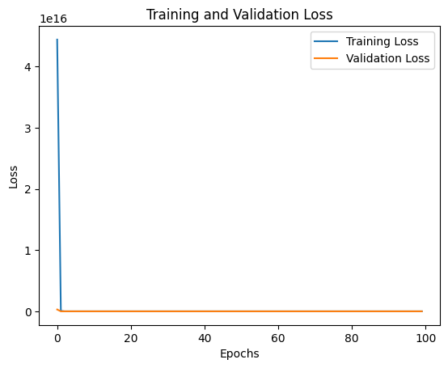
CNN 1
At Last Epoch(100) :
loss: 14.0638
mae: 2.5017
val_loss: 14.1594
val_mae: 2.5035
~ CNN_1.ipynb

Slide 6
ROADMAP
3) CNN 2 :
i) This uses variable loads at variable positions and of variable magnitude as input and matches the prediction with the output displacement data through FEM.
ii) The FEM data is first converted from string to float through a code to be able to access it as a numpy array
iii) The CNN is then trained for 2 convolutions and 9 dense neural network layers after being flattened to give prediction.
iv) a 100 epochs with batch size 32 are run to determine the model under decent losses
~ CNN_2.ipynb

Slide 7
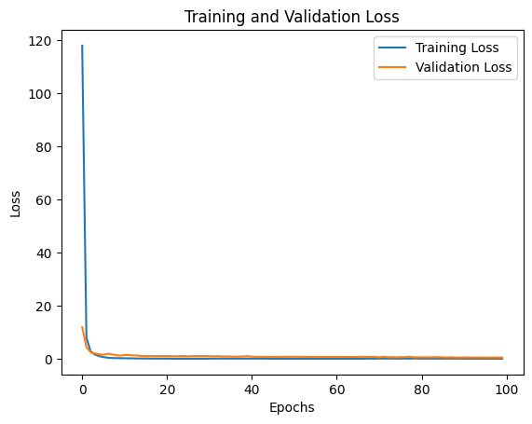
CNN 2
At Last Epoch(100) :
loss: 0.0076
mae: 0.0558
val_loss: 0.4603
val_mae: 0.3711
~ CNN_2.ipynb

Slide 8
ROADMAP
4) CNN 3 :
i) This uses the load corresponding maximum stress in the beam and the variable properties as input and matches the prediction with the output displacement data for the corresponding load through FEM.
ii) The FEM data is first converted from string to float through a code to be able to access it as a numpy array
iii) The CNN is then trained for 2 convolutions and 9 dense neural network layers after being flattened to give prediction.
iv) a 100 epochs with batch size 32 are run to determine the model under decent losses
~ CNN_3.ipynb

Slide 9
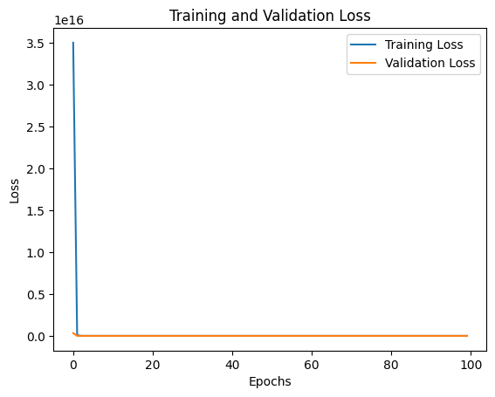
CNN 3
At Last Epoch(100) :
loss: 14.0627
mae: 2.5018
val_loss: 14.0627
val_mae: 2.5018
~ CNN_3.ipynb

